Slide 1
TUNER PRO
Product range, features and use cases

Slide 2
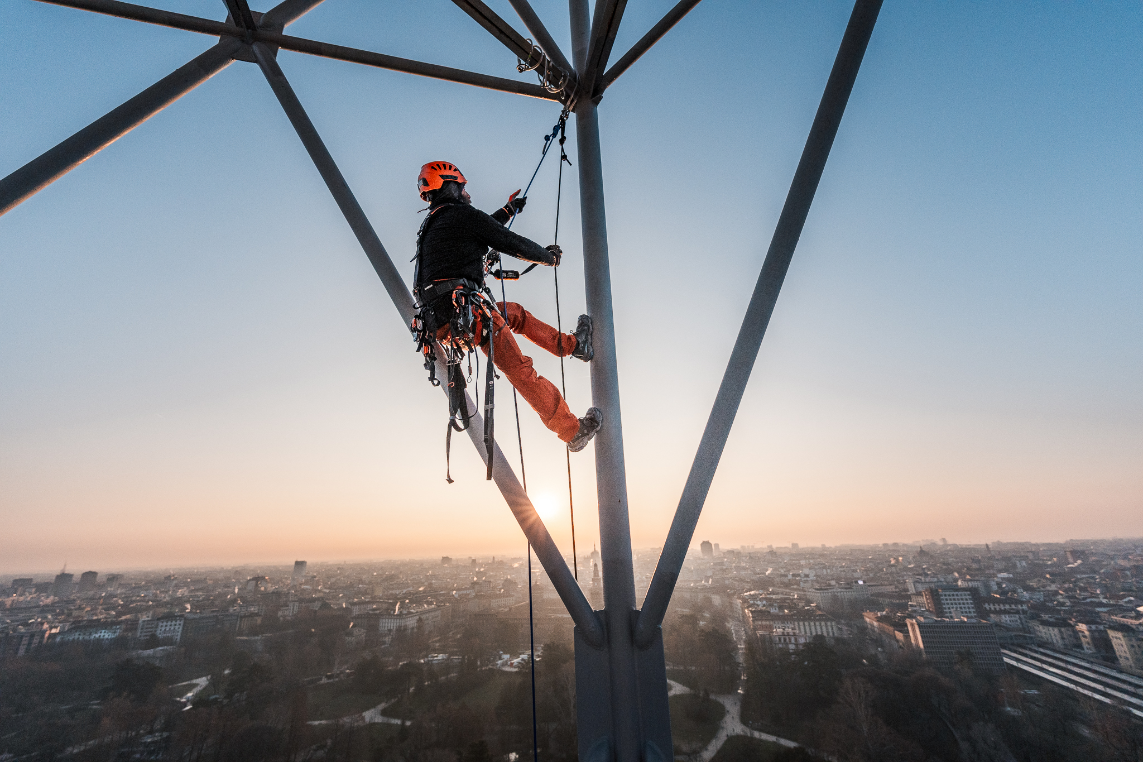

Slide 3
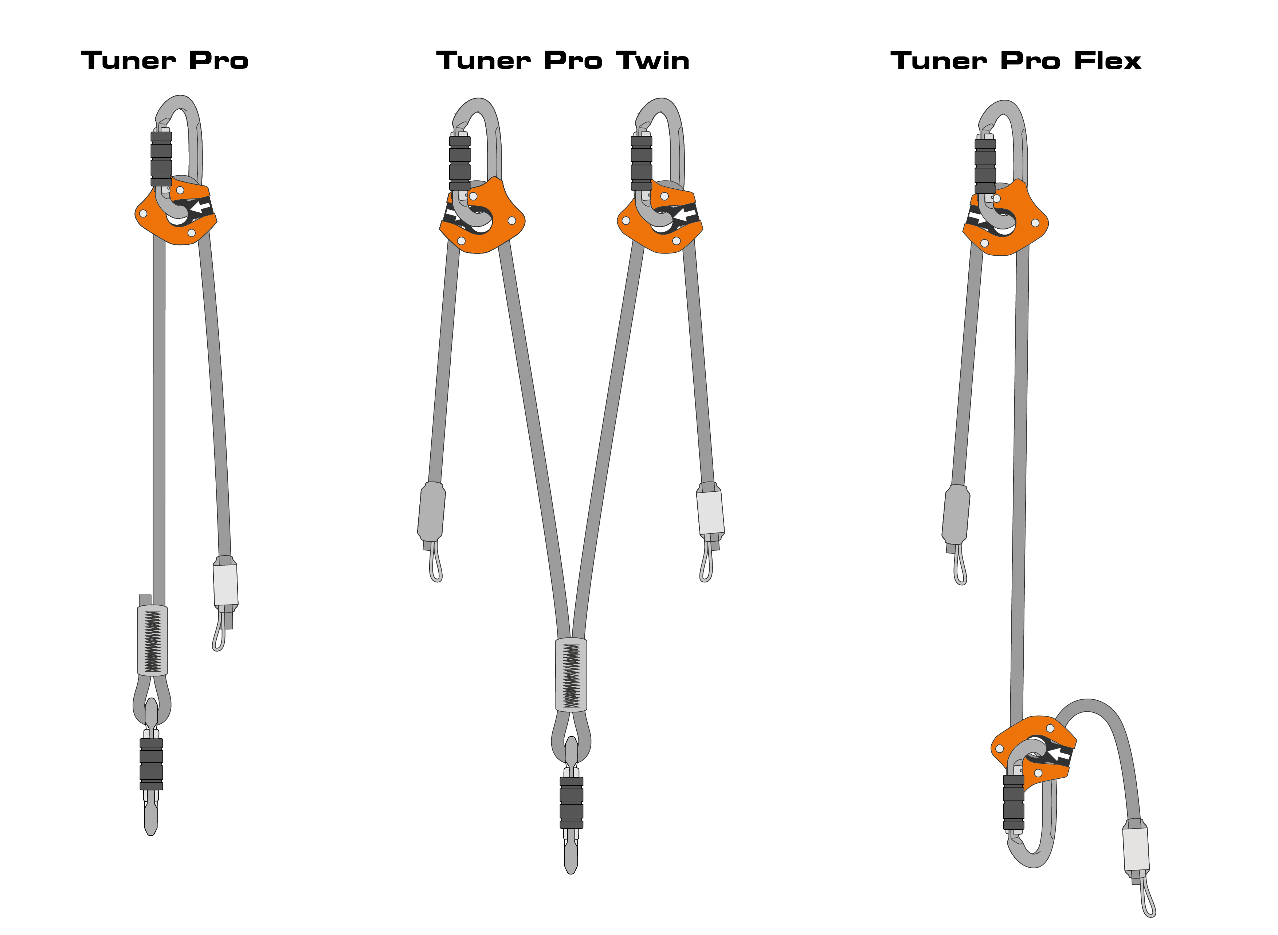
TUNER PRO
PRODUCT RANGE
LIGHTWEIGHT ADJUSTABLE LANYARD FOR INDUSTRIAL APPLICATIONS:
Work positioning
Anchor
Restraint
Rescue
ONLY LANYARD ON THE MARKET THAT CAN BE USED WITH ANY CONNECTOR

Slide 4
TUNER PRO
DIMENSIONS AND STANDARDS
Standards:
EN358-150kg
EN795-B
CEN TS 16415-2 people (RESCUE ONLY)
Standards:
EN358-150kg
Standards:
APAVE PROTOCOL
Based on
EN358-150kg

Slide 5
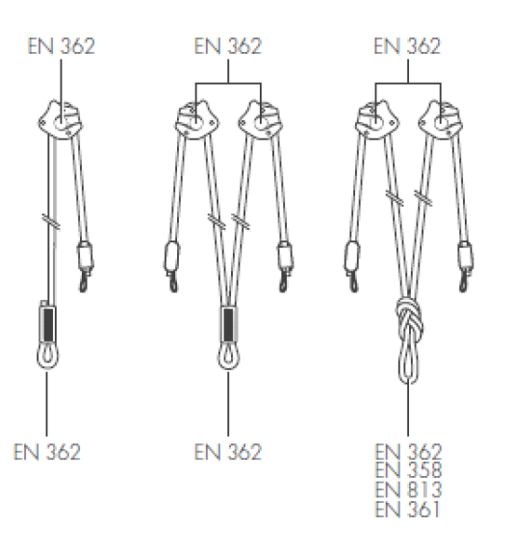
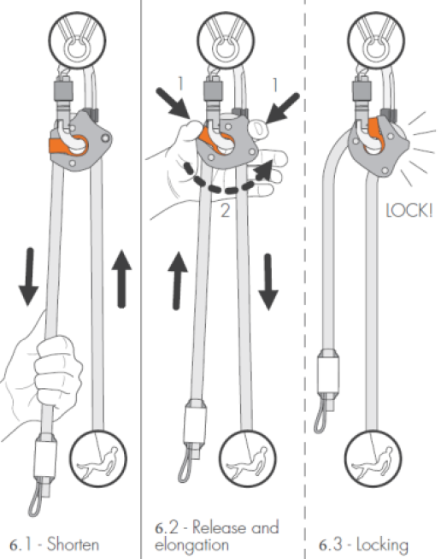
TUNER PRO
COMPATIBILITY AND ADJUSTMENT

Slide 6
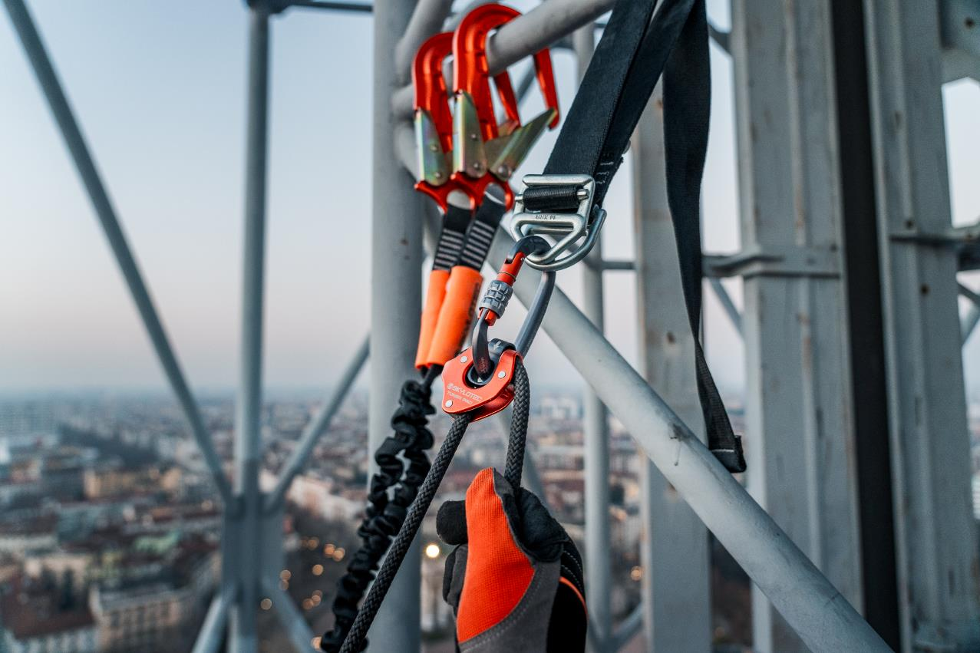

Slide 7
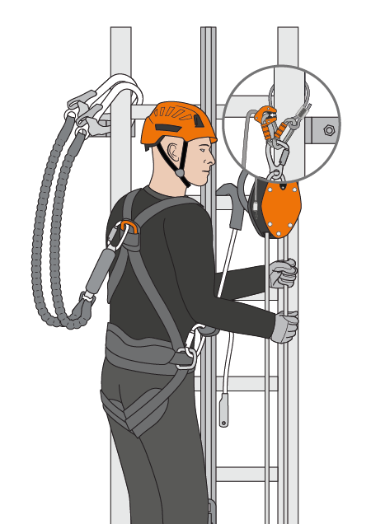
TUNER PRO
USE CASE EXAMPLES

Slide 8
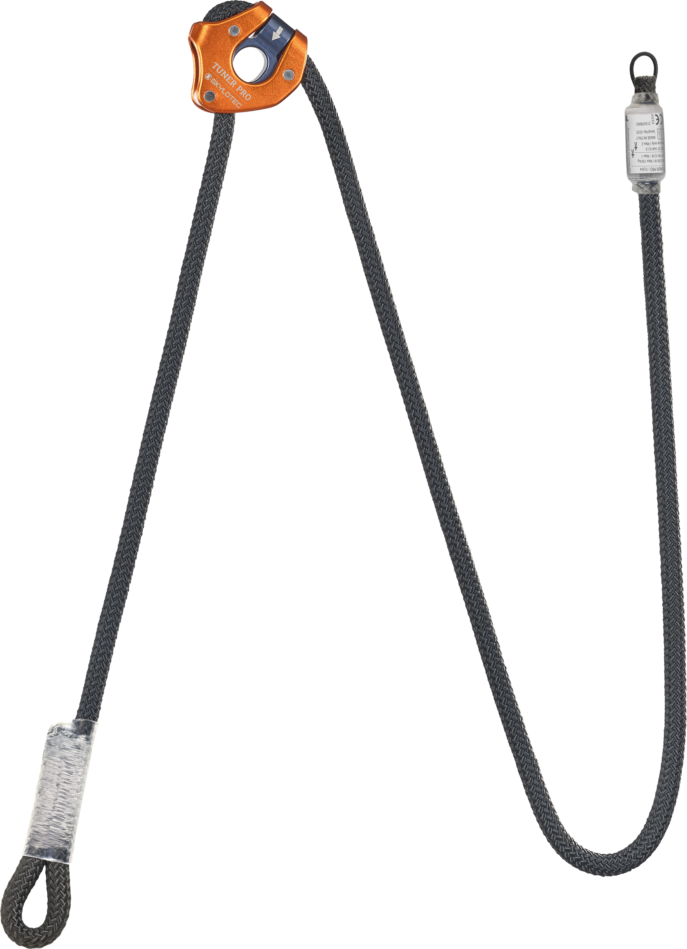
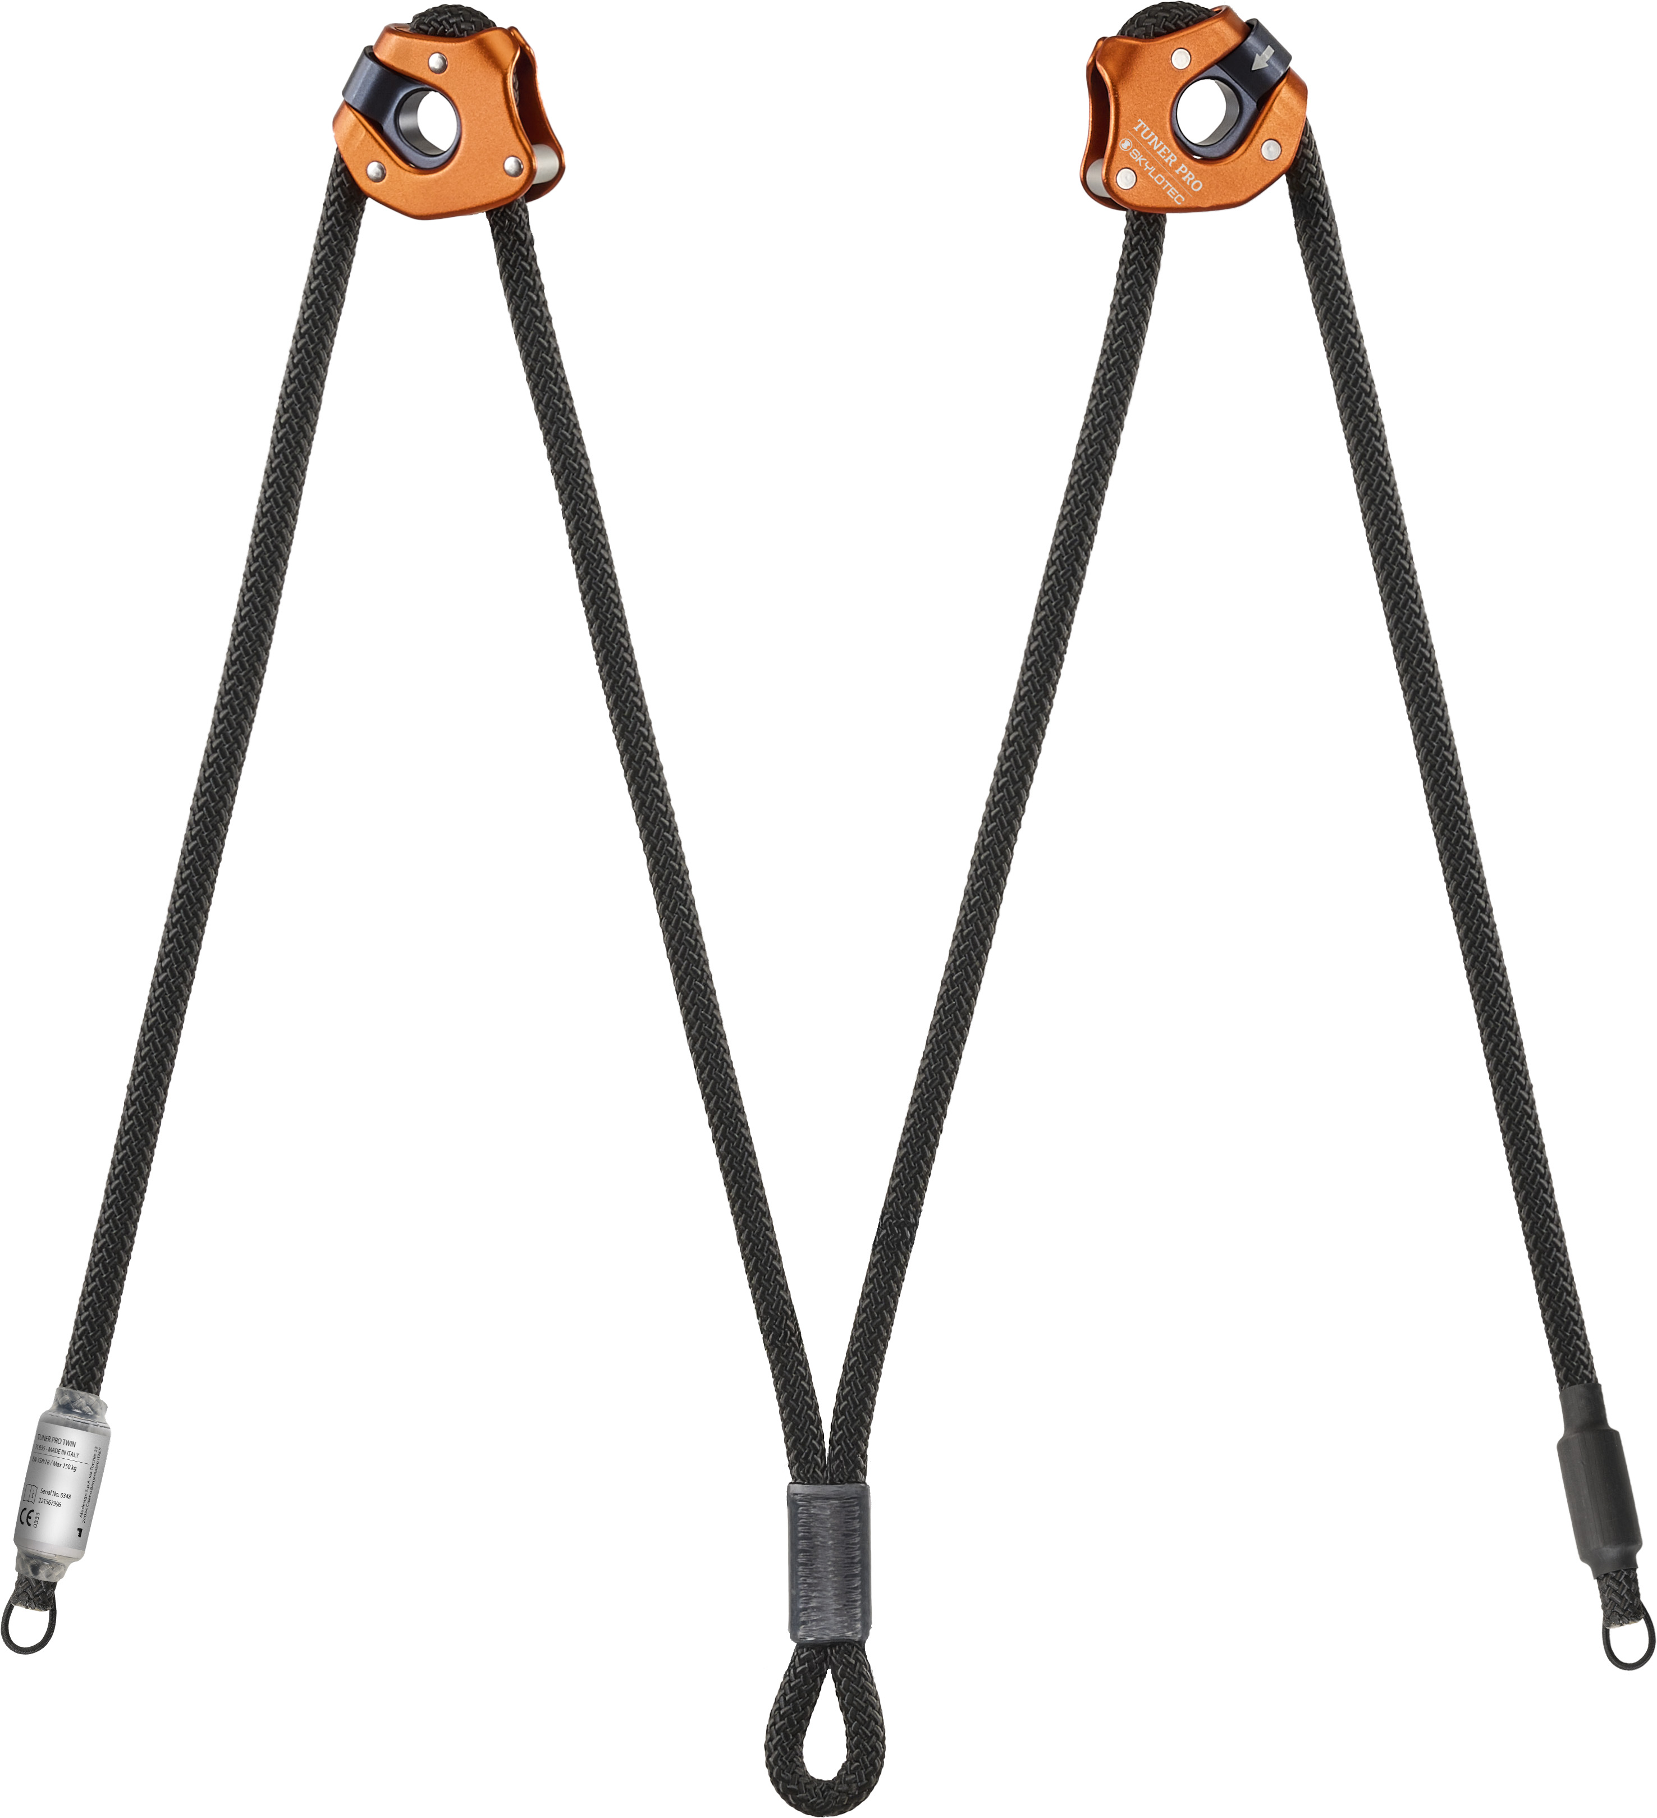
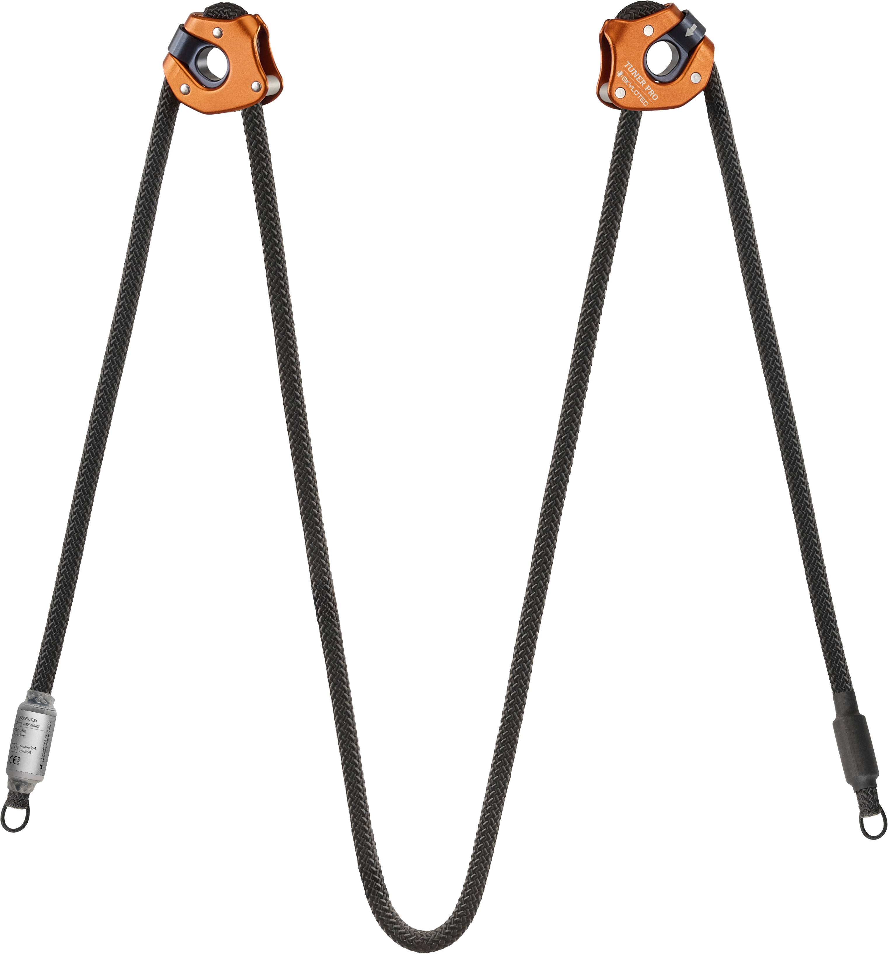
TUNER PRO
BENCHMARKING
WHY CHOOSE TUNER PRO?
huge compatibility with different types of connectors
best adjustability to and from the anchor
lightweight yet durable (9,6mm Type A rope)
multiple ways of connection
biggest range of use cases
rescue capabilities in different scenarios with SKYLOTEC devices
parking loop for clean and tidy storage of spare rope
endless possibilites of customization for other use case

Slide 9
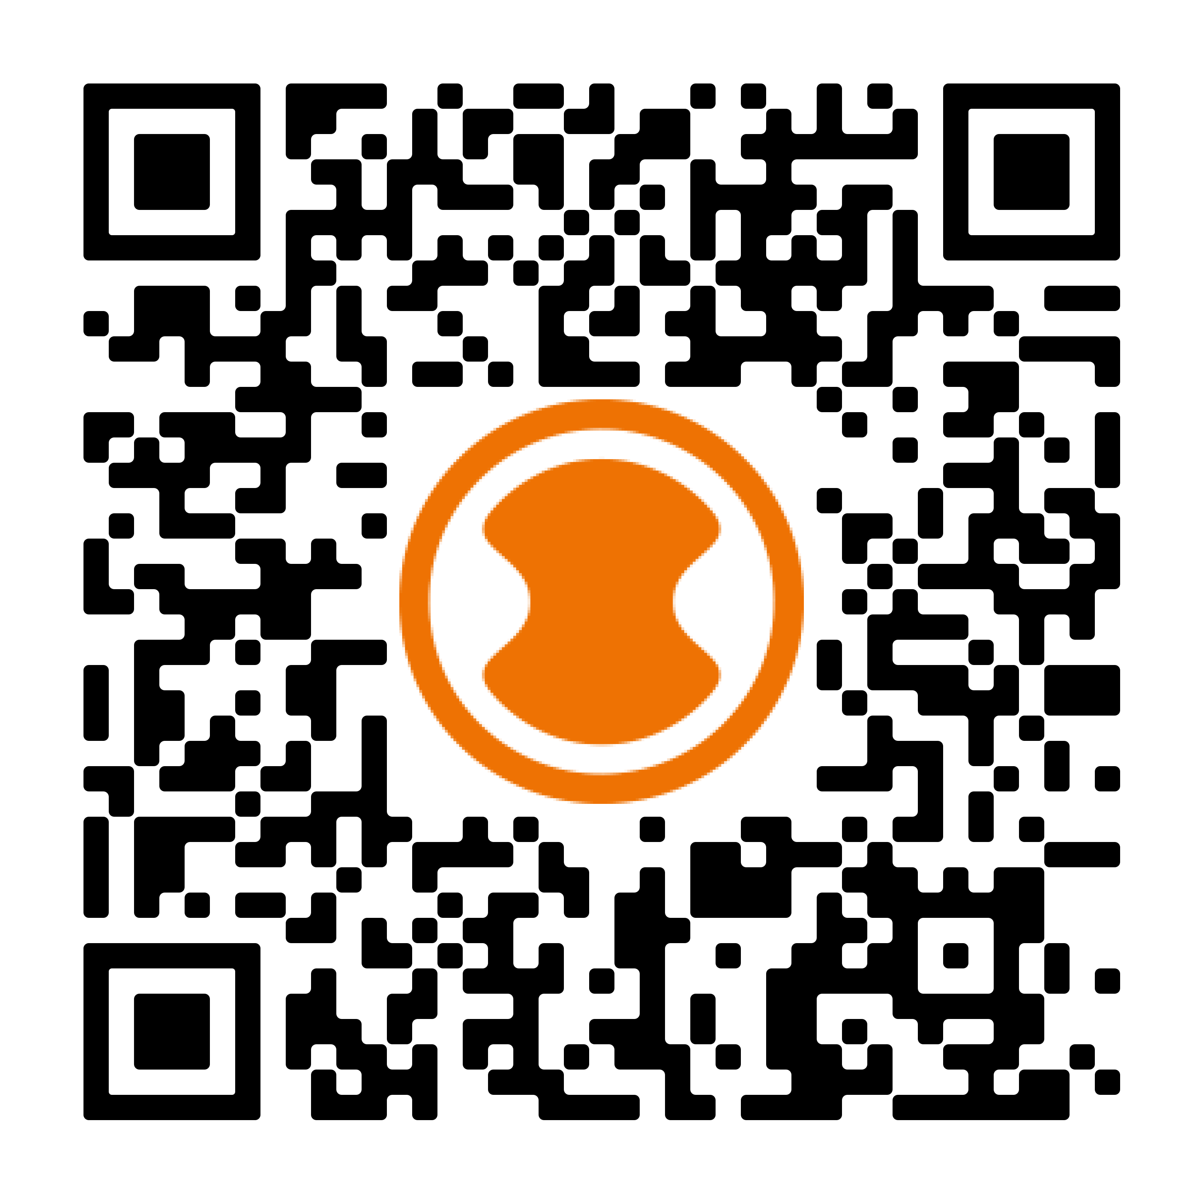
TUNER PRO
VIDEOS
Application video:
https://youtu.be/_lpXbIySAvc?si=_bh5ueeLujC0ET5q
Tutorial video:
https://youtu.be/MfioRfLuQDY?si=ciF2sVfZkCuyZO8w

